Slide 1
ANTIPSYCHOTICS

Slide 2
Psychotic Disorders
Definition: Psychotic disorders are defined as mental disorders in which the personality is severely altered and a person’s contact with reality is impaired.
Characteristics: Delusions, hallucinations, odd behavior, and incoherent or disorganized speech
Causes: Traumatic Experience, Stressful Event, and Drug Use
The most important types of psychosis are:
  Schizophrenia
  Affective disorders (e.g. depression, mania)
  Organic psychoses (mental disturbances caused by head injury, alcoholism, or other kinds of organic disease).

Slide 3
Major Psychotic Disorders
Brief Psychotic Disorder
Delusional Disorder
Schizoaffective Disorder
Schizophreniform
Shared Psychotic Disorder
Schizophrenia

Slide 4
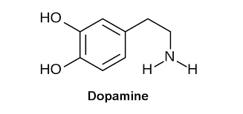
Dopamine Receptors in Schizophrenia
D1, D2, D3, D4 and D5
All are G-Protein Coupled Receptors
Classification
D1: D5, Stimulate Adenyl Cyclase
D2: D3,D4, Inhibit Adenyl Cyclase
Schizophrenia is a serious brain illness which are characterized by severe problems with a person’s
thoughts,
feelings,
behavior,
and use of words and language.

Slide 5
Treatment Before Drugs Came into Play
Patients were kept isolated from everybody else.
Shock Treatment: consisted of twirling patients on a stool until they lost consciousness or dropping them through a trap door into an icy lake
Insulin-Shock Therapy: consisted injecting insulin into the patient until he or she became hypoglycemic enough to lose consciousness and lapse into a coma
Institutionalized

Slide 6
Anti-psychotic Drugs
Antipsychotic drugs (also known as major tranquilizers because they tranquilize and sedate) mitigate or eliminate the symptoms of psychotic disorders but they do not cure them.
Antipsychotic drugs were initially called neuroleptics because they were found to cause neurolepsy, which is an extreme slowness or absence movement.

Slide 7
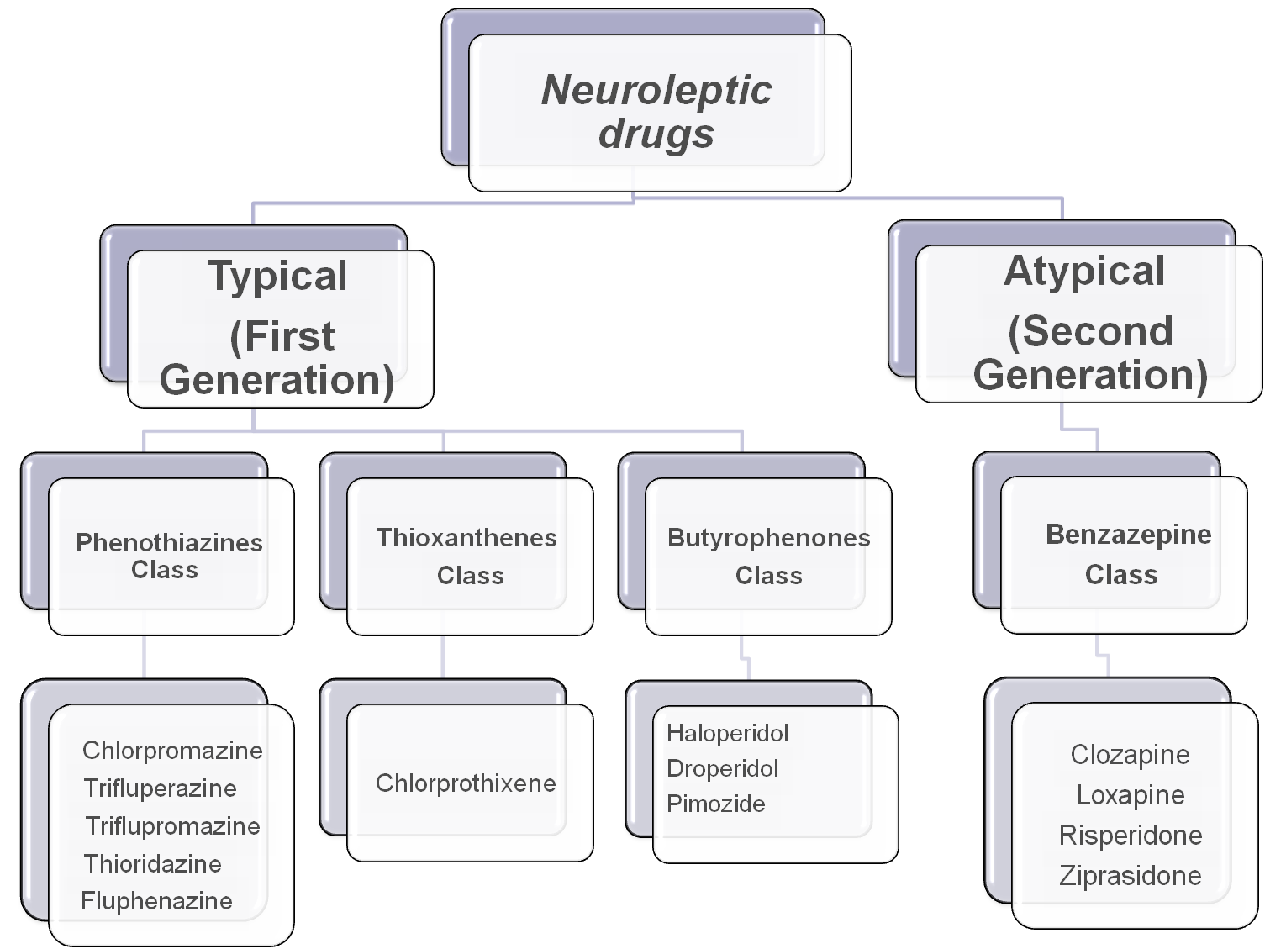

Slide 8
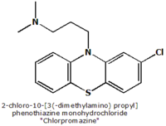
Antipsychotic Drugs
Chlorpromazine was the
first anti-psychotic drug
developed
Initially this drug was administered to
patients before a surgery because it produced anti- anxiety effects. It was
then tried on patients with mental illnesses and it was discovered that
it relieved psychotic episode symptoms.

Slide 9
Typical Antipsychotics
Phenothiazines and Butyrophenones are typical antipsychotics
These drugs are no longer regarded as the best practice for treating psychotic disorders, even though they are still commonly utilized in emergency treatments.
The reason for this is that they are not very selective. They do not only block the D2 receptors of the mesolimbic pathway but also block the D2 receptors in the nigrostriatal pathway, mesocortical zone, and tuberoinfundibular pathway.
The fact that they are not very selective causes the extra pyramidal symptoms such as tardive diskinesia

Slide 10
Atypical Anti-psychotics
Were developed in an attempt to minimize the side effects of typical anti-psychotics
They have proven to cause fewer extra pyramidal symptoms (EPS) when compared to typical anti-psychotics.
They produce fewer EPS because they are more selective.
They have reduced affinity for D2 Receptors

Slide 11

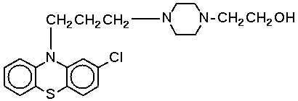
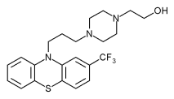
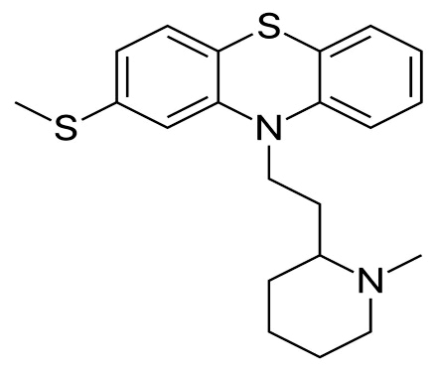
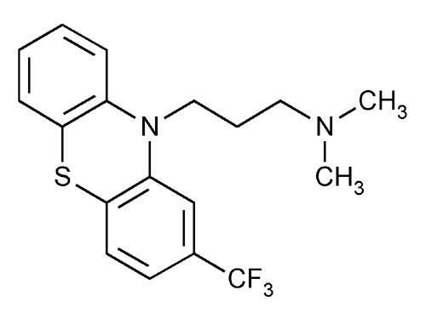
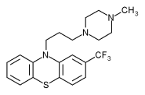
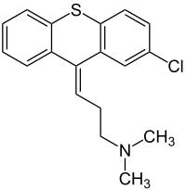
Phenothiazines
Chlorpromazine belongs to this class of drugs.
Other examples include:
Perphenazine
Fluphenazine
Thioridazine
Triflupromazine
Trifluoperazine
Chlorprothixen

Slide 12
STRUCTURE ACTIVITY RELATIONSHIP
The Electronegative Cl atom on ring is responsible for impairing asymmetry to this molecule. The attraction of amine side chain toward the ring containing Cl atom indicates important structural feature of such molecules.
Phenothiazines and related compounds lacking Cl atom in this position are inactive Neuroleptics.
For therapeutic efficacy of Phenothiazines, the side chain amine should contain 3 Carbon separating the 2 Nitrogen atoms.
Phenothiazines with 2 Carbon atoms separating the 2 Nitrogen atoms lack antipsychotic efficacy.

Slide 13
Mechanism of Action of Phenothiazines
The drugs found in this class are antagonists.
They work by blocking the D2 receptors in the dopamine pathways of the brain; thus, decreasing the normal effect of dopamine release.
Blocking the D2 receptors in the mesolimbic pathway results in the antipsychotic effect.
Metabolism is by CYP450 catalyzed pathway

Slide 14
Side Effects Associated with Phenothiazines
Pharmacological Side Effects
  Constipation
  Retention of urine
  Increased heart rate
  Dry mouth
  Dilated pupils
Serious Side Effects
    Parkinsonian like syndrome
    Dystonia
    Diskinesia
    Neuroleptic Malignant Syndrome (NMS)

Slide 15

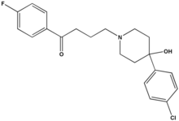
Butyrophenones
Butyrophenones are high-potency antipsychotics (potency refers not to effectiveness but rather to the ability to bind to dopamine receptors)
Haloperidol (Haldol)
is the most common
drug of the
butyrophenones

Slide 16
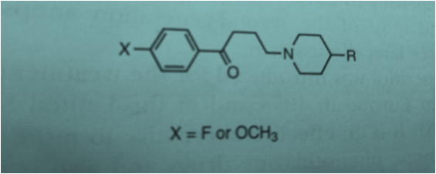
STRUCTURE ACTIVITY RELATIONSHIP
The attachment of tert. Amino group to 4th C of Butyrophenone is essential for Neuroleptic Activity.
Lenthening, shortening or branching of 3 carbon Propyl chain decreases Neuroleptic Potency.
Replacement of keto moiety with thioketone, olefinic or phenoxy group decreases Neuroleptic Potency.
Most Potent Butyrophenones have F substituent in para position of the benzene ring.
Variations are possible in tertiary amino group without loss of Neuroleptic Potency.

Slide 17
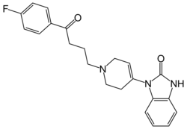
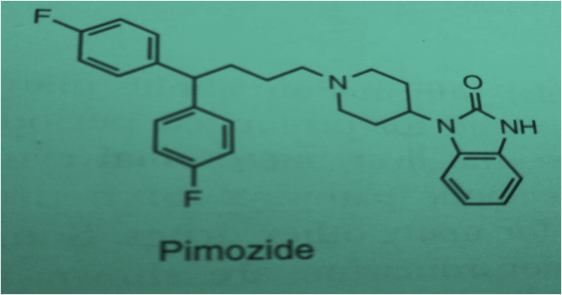
Other Butyrophenones
Droperidol
Pimozide

Slide 18
Mechanism of Action
All the butyrophenones work in the same manner as the phenothiazines.
They block the D2 receptors in the dopamine pathways, thus, thwarting any possible over excitation of the dopamine receptors.

Slide 19
Side Effects of Butyrophenones
Pharmacological effects include:
  Dry mouth
  Urinary retention
  Dimmed sight
  More Serious Side effects include:
  - Dystonia
  - Tardive Dyskinesia
  - Akathisia

Slide 20
Comparisons Between the Two Classes of Drugs
Phenothiazines
  Low potency
  Are sedative
  Block D2 receptors
  metabolism and removal of phenothiazines is complex and among the slowest of any group of drugs
  cause extra pyramidal symptoms
Butyrophenones
  High potency
  Non-sedative
  Block D2 receptors
  Metabolism and removal is quicker
  Cause extra pyramidal symptoms

Slide 21
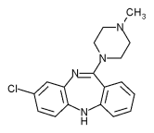
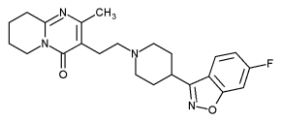
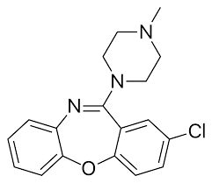
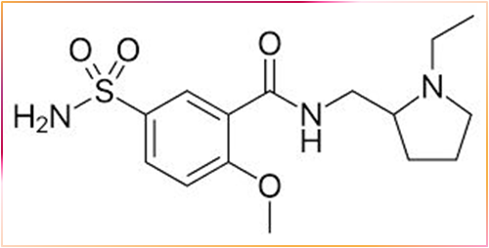
Common Atypical Antipsychotics
Clozapine
Loxapine
Risperidone
Sulpiride

Slide 22
Mode of Action
Antagonists
Atypical antipsychotic drugs have a similar blocking effect on D2 receptors but appear to be more selective in targeting the intended pathway to a larger degree than typical antipsychotics.
They also interact with other neurotransmission systems, particularly with the serotonergic and noradrenergic pathways.

Slide 23
Side Effects with Atypical Antipsychotics
Glucose Metabolism Disorders such as hyperglycemia, onset of diabetes type 2, and worsening of pre-existing diabetes ( This was particularly seen with patients treated with olanzapine and clozapine)
Weight Gain has been seen with patients taking Olanzapine; the increase of weight gain can result in other heart diseases such as hypertension and coronary heart disease.
QTc prolongation which occurs when there is an abnormally long delay between the electrical excitation and relaxation of the ventricles of the heart which can cause death

Slide 24

Most Common Problems Associated with Antipsychotic Treatment
The slow onset of antipsychotic efficacy
The development of antipsychotic-induced side effects
Patients’ vulnerability to relapse following antipsychotic drug discontinuation.

